Slide 1
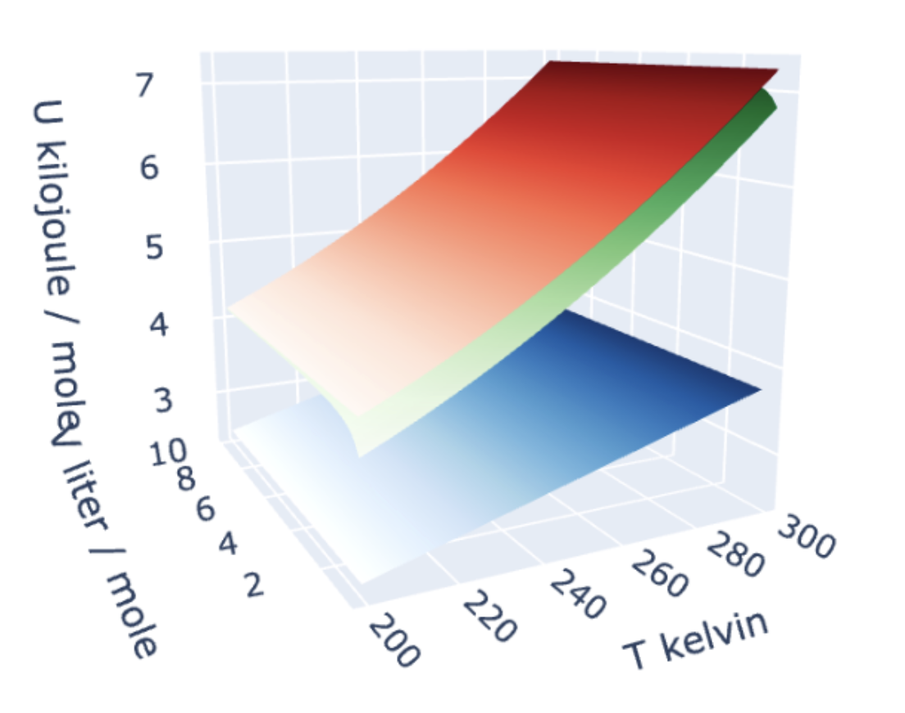

Week 4 – Introduced $U(T,V)$ as a measure of a system’s energy
The energy in a sample (say, a mole of gas) can take various forms:
There’s translational and rotational motion, which is all kinetic energy:
$$U(T,V)$$
There’s also vibrational motion, in which kinetic energy and potential energy are constantly trading off.

Slide 2
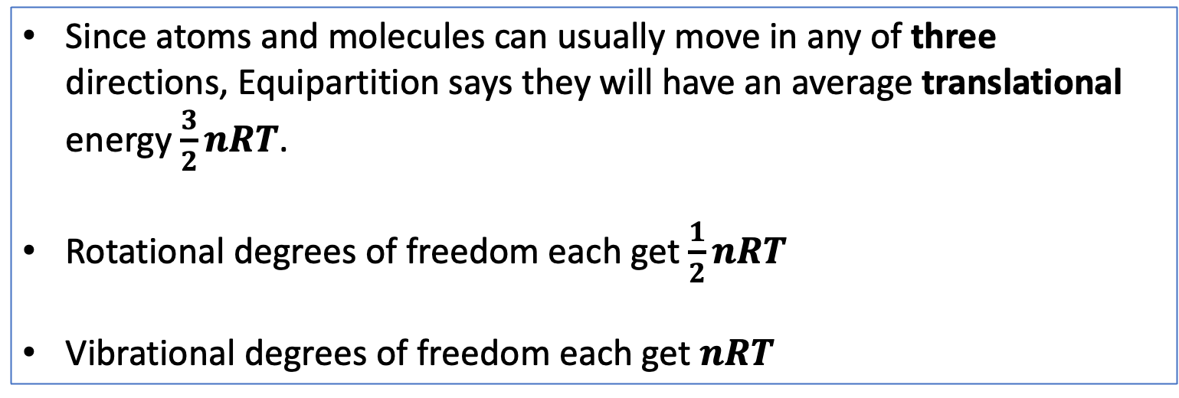
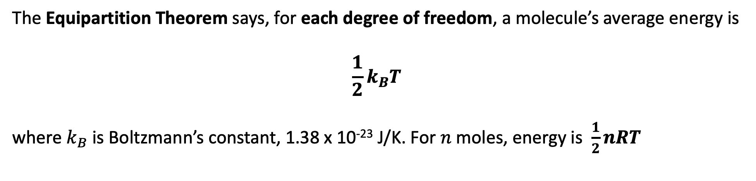
Week 4 – Predicted $U(T,V)$ from the Equipartition Theorem
The Equipartition Theorem says, for each degree of freedom, a molecule’s average energy is
$$\frac{1}{2}k_{B}T$$
where $k_{B}$ is Boltzmann’s constant, 1.38 x 10⁻²³ J/K. For $n$ moles, energy is $\frac{1}{2}nRT$
Since atoms and molecules can usually move in any of three directions, Equipartition says they will have an average translational energy $\frac{3}{2}nRT$.
Rotational degrees of freedom each get $\frac{1}{2}nRT$
Vibrational degrees of freedom each get $nRT$

Slide 3
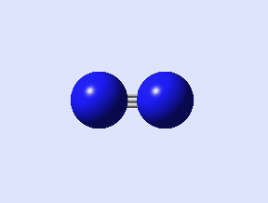
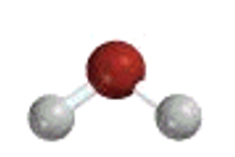





The kind of question I might ask – Heat capacities for vibrational motion
$$C_{V}=$$
$$C_{V}=$$
Low-temperature limit
High-temperature limit
$$C_{V}=$$
High-temperature limit
$$C_{V}=$$
$$C_{V}=$$
Low-temperature limit
High-temperature limit

Slide 4

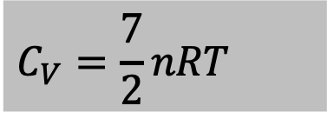

The kind of question I might ask – Heat capacities for vibrational motion
$$C_{V}=\frac{7}{2}nRT$$
$$C_{V}=$$
Low-temperature limit
High-temperature limit
$$C_{V}=$$
High-temperature limit
$$C_{V}=$$
$$C_{V}=$$
Low-temperature limit
High-temperature limit

Slide 5
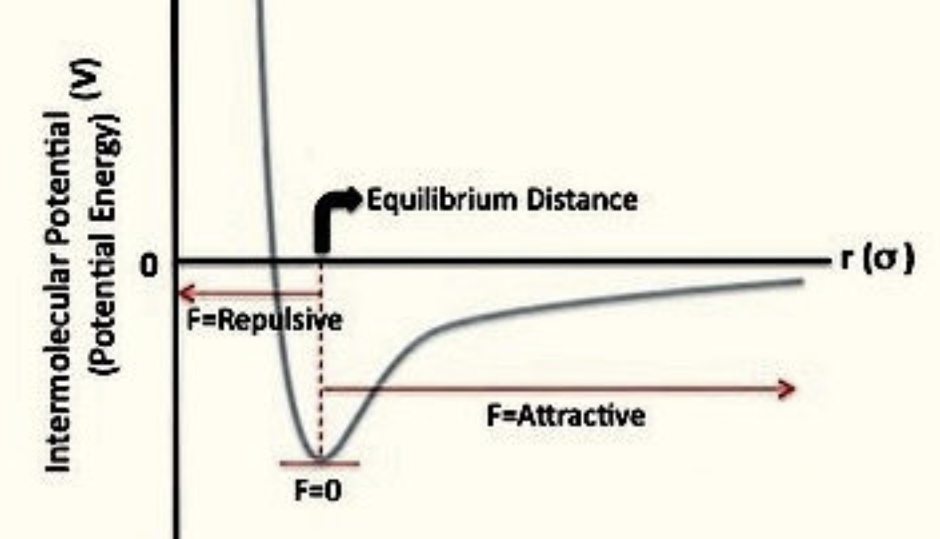
Week 4 – Intermolecular attractions and potential energy
Here’s what a typical potential energy curve looks like between two real atoms; we called this “stickiness” before. Notice that the energy is negative over most of the distances.
Intermolecular attractions must be overcome when increasing the volume

Slide 6
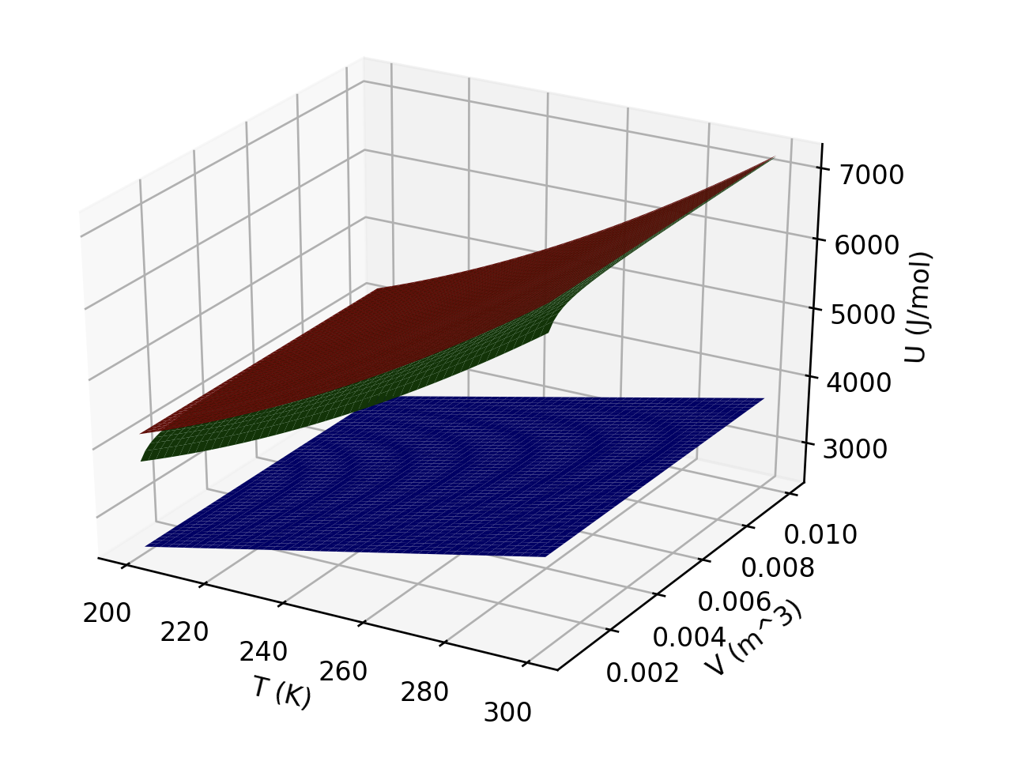
The kind of question I might ask – Interpreting U(T,V)
What is responsible for the curvature of the red and green gases in the temperature direction?
Which gas(es) could be ideal?
Which is/are probably monatomic?
Notes:
Week 4

Slide 7
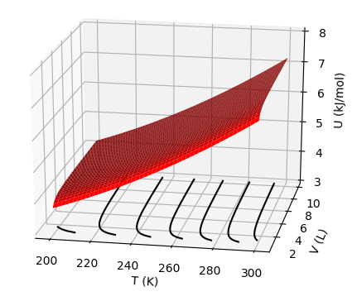



Week 4 – Differential equation of state for $U(T,V)$
$${\left(\frac{∂U}{∂T}\right)}_{V}$$
$$dU=C_{V}dT+π_{T}dV$$
$${\left(\frac{∂U}{∂V}\right)}_{T}$$

Slide 8
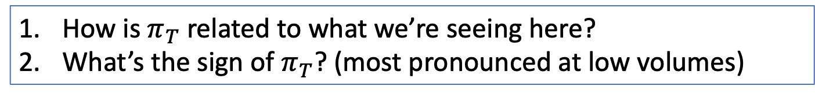
The kind of question I might ask – $π_{T}$
$${\left(\frac{∂U}{∂T}\right)}_{V}$$
$$dU=C_{V}dT+π_{T}dV$$
$${\left(\frac{∂U}{∂V}\right)}_{T}$$
How is $π_{T}$ related to what we’re seeing here?
What’s the sign of $π_{T}$? (most pronounced at low volumes)

Slide 9
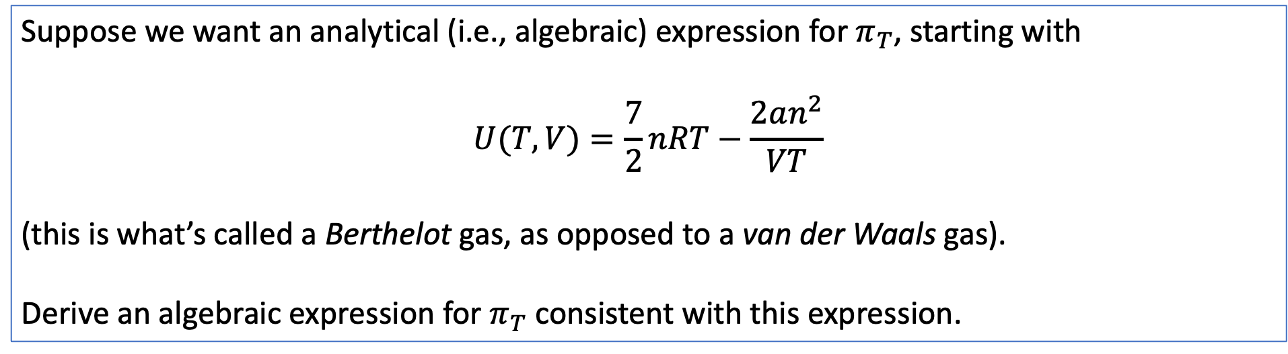
The kind of question I might ask – Analytical $π_{T}$
Suppose we want an analytical (i.e., algebraic) expression for $π_{T}$, starting with
$$U(T,V)=\frac{7}{2}nRT−\frac{2an^{2}}{VT}$$
(this is what’s called a Berthelot gas, as opposed to a van der Waals gas).
Derive an algebraic expression for $π_{T}$ consistent with this expression.
Notes:
Week 4

Slide 10

The kind of question I might ask – Contours of $U(T,V)$
$$dU=C_{V}dT+π_{T}dV$$
${\left(\frac{∂U}{∂T}\right)}_{V}$
${\left(\frac{∂T}{∂V}\right)}_{U}$
${\left(\frac{∂U}{∂V}\right)}_{T}$
Which is the correct description of the slopes of these lines?

